Slide 1
Section 7.6
Double-angle and Half-angle Formulas

Slide 2


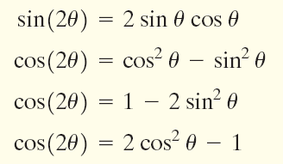

Slide 4

− 2
5

Slide 6







Slide 7




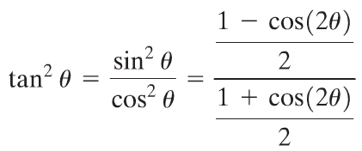


Slide 8








Slide 9


Slide 10


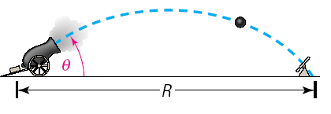



Slide 12


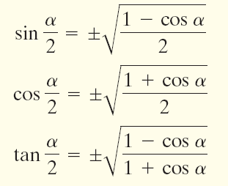

Slide 13
Use a Half-angle Formula to find the exact value of:
(a) sin 22.5° (b) cos

Slide 15



